Slide 1
Cartesian Vectors
In right-handed Cartesian coordinated system, the right thumb points in the positive z direction when the right hand figures are curled from positive x direction to positive y direction about the z axis.
The three axes x, y and z are right angle to each other.
The unit vectors I, j and k are the unit vectors along the x, y and z axes, respectively.
z
k
F_{z}
F
F_{y}
y
j
F_{x}
F_{xy}
i
x

Slide 2

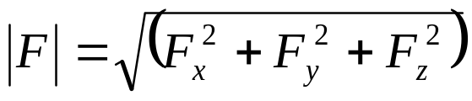
Representation and Magnitude of Vector
Vectors are represented by the magnitudes and directions of the three components using the unit vectors I, j and k. e.g.
The magnitude of the vector is given as

Slide 3

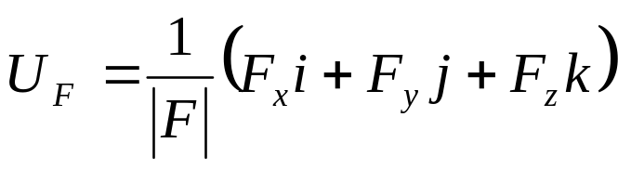
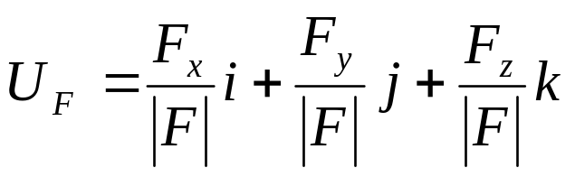
Unit Vector
A unit vector is vector with unit (1) magnitude.
If

Slide 4
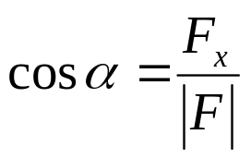
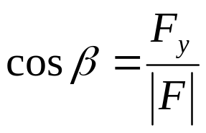

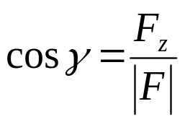




Direction Cosines
The direction cosines are the cosine of angles between the tail of a vector and the positive x, y and z axes.
z
Direction Cosines
k
F_{z}
F
F_{y}
y
j
F_{x}
Note that
i
x

Slide 5
Example
Determine the magnitude and coordinate direction angles of the resultant force.
z
4 kN
30º
135º
y
60º
60º
x
10 kN

Slide 6
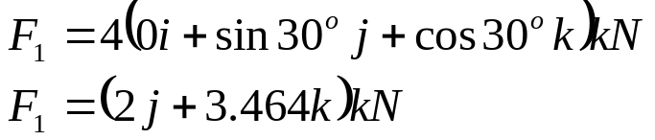
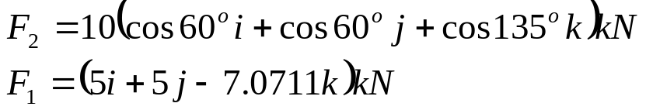
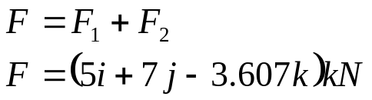
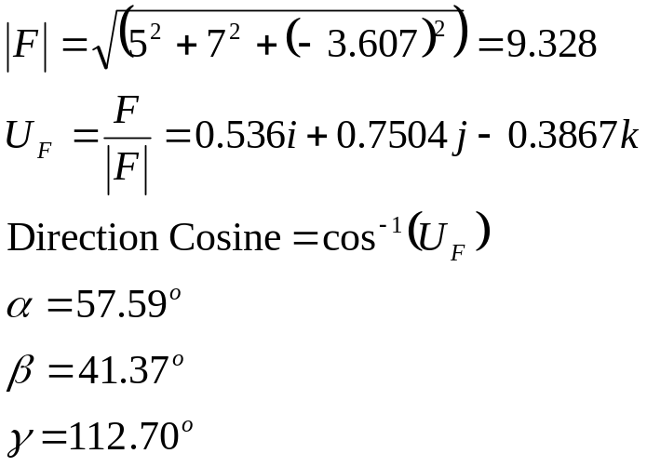
Solution
z
4 kN
30º
135º
y
60º
60º
x
10 kN

Slide 7
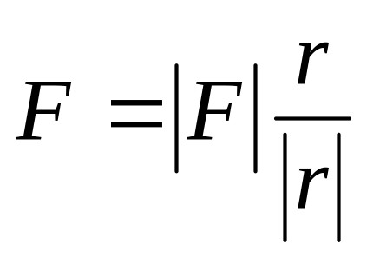
Force Vector Directed Along a Line
If a force of magnitude /F/ is directed along a line r, then the force vector is defined as

Slide 8
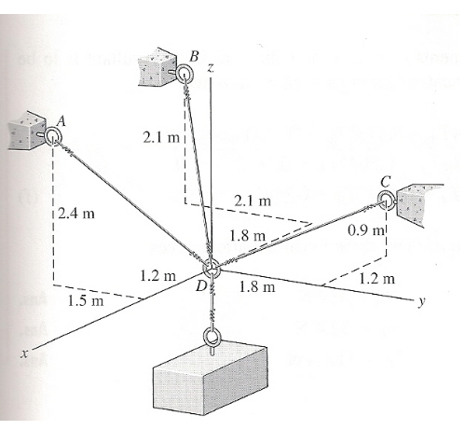
Example
A 500-N block is supported by a system of cables as shown in . Determine the tension in the cables A, B and C.

